Slide 1
A better future for children without violence
Examining the evidence for ending corporal punishment
Chaired by Professor Sophie Havighurst & Professor Daryl Higgins
With Professor Ben Mathews and Professor David Hawes

Slide 2
Seminar Overview
Introduction/Welcome – Professors Sophie Havighurst and Daryl Higgins
Where PAFRA began with this project, journal paper and advocacy campaign group
The current state of legislation – Professor Ben Mathews
Research on the harmful impacts – Professor Daryl Higgins
Alternative parenting strategies – Professor David Hawes
International experiences of banning corporal punishment – Professor Sophie Havighurst
Recommendations and call to action – Professor Sophie Havighurst
Questions and Discussion

Slide 3
Beginning with a review of the evidence…
Corporal Punishment of Children in Australia: The Evidence-Based Case for Legislative Reform
Sophie S. Havighurst, Ben Mathews, Frances L. Doyle, Divna M. Haslam, Karl Andriessen, Carmen Cubillo, Sharon Dawe, David J. Hawes, Cynthia Leung, Trevor G. Mazzucchelli, Alina Morawska, Sarah Whittle, Carys Chainey, & Daryl J. Higgins
Submitted to Australian and New Zealand Journal of Public Health

Slide 4
A BETTER FUTURE FOR CHILDREN WITHOUT VIOLENCE: EXAMINING THE EVIDENCE FOR ENDING CORPORAL PUNISHMENT
The current state of legislation
Professor Ben Mathews
Principal Research Fellow, School of Law, Queensland University of Technology
Australian Centre for Health Law Research
Adjunct Professor, Johns Hopkins University, Bloomberg School of Public Health
b.mathews@qut.edu.au
https://www.australianchildmaltreatmentstudy.org

Slide 6
What do we mean by
“corporal punishment”?
“the use of physical force
with the intention of causing a child to experience pain, but not injury,
for the purpose of correcting or controlling the child’s behaviour”
Donnelly & Straus (2005)
“any punishment in which physical force is used and intended to cause some degree of pain or discomfort, however light, as well as non-physical forms of punishment that are cruel and degrading”
Global Initiative to End All Corporal Punishment Against Children (2019)

Slide 7

Global legal context: expanding legal prohibitions of corporal punishment
Legal prohibition commenced Sweden 1979
Proliferated globally, most recently in Republic of Korea, Colombia
Now prohibited in 63 nations + 26 committed to reform
Catalysed by:
Understanding of harms caused
Promotion of children’s rights
Awareness of alternative methods of discipline
International structures and norm-setting bodies (UN CRC art 19, 37), UN Committee on the Rights of the Child General Comment 8)

Slide 8
But not Australia. Why? A bit of legal history
Australian States & Territories imported English law on white settlement
English law is based on Roman law, which treated children as the father’s property (powers of abandonment, punishment, sale, death) (Borkowski, 1994; Gardner, 1986; Thane, 1981)
English law endowed parents with:
  duties to the child: maintenance, protection, and education
  powers over the child: correction, receipt of labour, receipt of profits
Through 1800s: father had ‘control over the person, education and conduct of his children’ (In re Agar-Ellis (1883))
A parent may chastise his or her child “in a reasonable manner; for this is for the benefit of his education” (Blackstone, 1765)
Child’s duty: to ‘owe subjection and obedience’ to parents during childhood, and owe ‘honour and reverence ever after’.

Slide 9
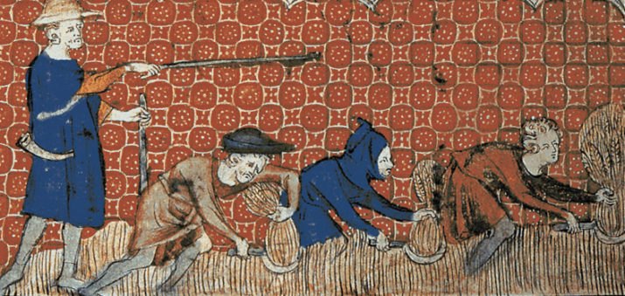

Where are we now in Australia?
The current law
Each State & Territory has power to make its own criminal laws
No single national law governs CP
Potential for different approaches across States/Territories
Yet, while differences exist, overall core principles are similar
Key point: All current Australian CP laws flow from the English law and the social and political forces that shaped it.
But we no longer live in that social, scientific, or normative context.

Slide 10
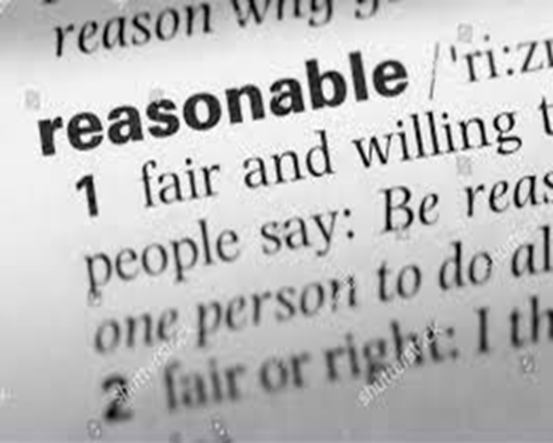
Where are we now in Australia?
A summary of the current law
5 jurisdictions (NSW, NT, QLD, TAS, WA)
Sections in criminal legislation/codes make it lawful to use “reasonable” CP
Applies to parent/person in place of parent)
Concept of “correction” (Tas, WA)
Concepts of “discipline, manage, or control” (NT, Qld)
3 jurisdictions (ACT, SA, VIC)
No sections in criminal legislation make CP lawful
Instead, adopt common law (court decisions) making “reasonable” CP lawful

Slide 11
Where are we now in Australia?
A summary of the current law
Reasonable corporal punishment is lawful in all 8 States & Territories
But what is “reasonable” corporal punishment?
Not always clear. May require court decisions / legislative definition
Courts consider several circumstances in determining if CP is “reasonable”:
whether the child is sufficiently old to be physically corrected (to cognitively understand their behaviour and the response to it)
the child’s sex and physical development
whether correction was administered by hand or with an implement
the nature of the physical correction
the nature of any injury or pain produced (amount, duration).
Police v G, DM (2016); Lumb v Police [2008]; R v Terry [1955]

Slide 12
NSW criminal legislation has embedded some of these principles
Crimes Act 1900 (NSW) s 61AA.
Allows application of force if:
It was reasonable having regard to the: age, health, maturity or other characteristics of the child, the nature of the alleged misbehaviour or other circumstances.
It will not be reasonable if force is applied:
to any part of the head or neck, or
to any other part of the body of the child in such a way as to be likely to cause harm to the child that lasts for more than a short period”
But even this leaves grey areas, uncertainty, and room for interpretation

Slide 13

Legal reform, consequences, and social norms
Does legal prohibition of CP promote a police state? Proliferating prosecutions?
No; major limits on prosecution
Alternative responses (e.g., cautions)
Prosecutorial Guidelines
Experience of other countries
Benefits include:
Laws establish social norms
Encourage specified behaviours, discourage/prohibit others
Support alternative methods of effective, healthy discipline/parenting
Promotion of rights, health, public health

Slide 14
Selected references
Legislation
Crimes Act 1900 (NSW) s 61AA
Criminal Code (NT) s 27(p)
Criminal Code (Qld) s 280
Criminal Code Act 1924 (Tas) s 50
Criminal Code Act 1913 (WA) s 257
Case law
Lumb v Police [2008] SASC 198
Police v G, DM (2016) 258 A Crim R 75
R v Terry [1955] VLR 114
United Nations Committee on the Rights of the Child. (2007). General Comment No. 8: The Right of the Child to Protection from Corporal Punishment and Other Cruel or Degrading forms of Punishment (U.N. CRC/C/GC/8). http://www.refworld.org/docid/460bc7772.html
General
Borkowski, A. (1994). Textbook on Roman Law. Blackstone Press, London.
Donnelly, M., & Straus, M. (2005). Corporal punishment of children in theoretical perspective. New Haven: Yale University Press.
Gardner, J. (1986). Women in Roman Law and Society. Routledge, London.
Global Initiative to End All Corporal Punishment Against Children. (2019). https://endcorporalpunishment.org/
Thane, P. (1981). Childhood in History. In M King (Ed.), Childhood, Welfare & Justice. Batsford, London

Slide 15

PAFRA Seminar
The effects of corporal punishment
Professor Daryl Higgins
Director, Institute of Child Protection Studies
Australian Catholic University
daryl.higgins@acu.edu.au Twitter: @HigginsDaryl

Slide 16
Perceived benefits Actual findings
Immediate compliance from children, and more effective than no action or time out
(Gershoff, 2002; Larzelere & Kuhn, 2005)
Decreased compliance over time and increased aggression
(Gershoff, 2002; Larzelere & Kuhn, 2005)
Parental right to discipline children
Children’s right to be free of violence
Belief that:
there is positive link between ‘spanking’ and a positive child outcome (Gershoff & Grogan-Kaylor, 2016)
studies preclude demonstration of causal relationship between corporal punishment and negative effects (Larzelere et al., 2019)
75 studies in 13 countries:
of 111 effect sizes, only 1 showed significant positive link between ‘spanking’ and a positive child outcome
99% showed spanking assoc with negative outcomes
(Gershoff & Grogan-Kaylor, 2016)

Slide 17
Negative impact on children – short term
Aggression
Lack of empathy
Low self-esteem
Mental health problems
Negative parent-child relationship
Child aggression
Child antisocial behaviour
Child impaired cognitive ability (brain development affected negatively)
(Ferguson, 2013; Gershoff, 2002; Gershoff & Grogan-Kaylor, 2016; Larzelere & Kuhn, 2005; Paolucci & Violato, 2004; Pollok et al., 2022)

Slide 18
Possible reasons for negative impacts on children
Models the use of violent physical behaviour
Coincides with other forms of child maltreatment (particularly physical abuse)
Conveys message that dominance and force are a part of close relationships
Fails to teach children positive alternative behaviours
(Gershoff & Grogan-Kaylor, 2016; (Ferguson, 2013; Gershoff, 2002; Larzelere & Kuhn, 2005; Paolucci & Violato, 2004)

Slide 19
Negative impacts – long term
Linked with increased non-compliance and aggression over time
(Gershoff, 2002; Gershoff & Grogan-Kaylor, 2016)
Lower levels of moral internalisation, compromising a significant socialisation goal (Gershoff, 2002)
Interpersonal trauma in close relationships associated with externalising problems such as oppositional defiant and conduct problems (Price et al., 2013)
Traumatic experiences in interpersonal relationships associated with distress and mental health problems (Spinazzola et al., 2018)
Developmental, emotional, behavioural and interpersonal problems, and adverse impact on child’s emerging personality (D'Andrea et al., 2012)
Corporal punishment in childhood linked with using domestic violence as an adult

Slide 20
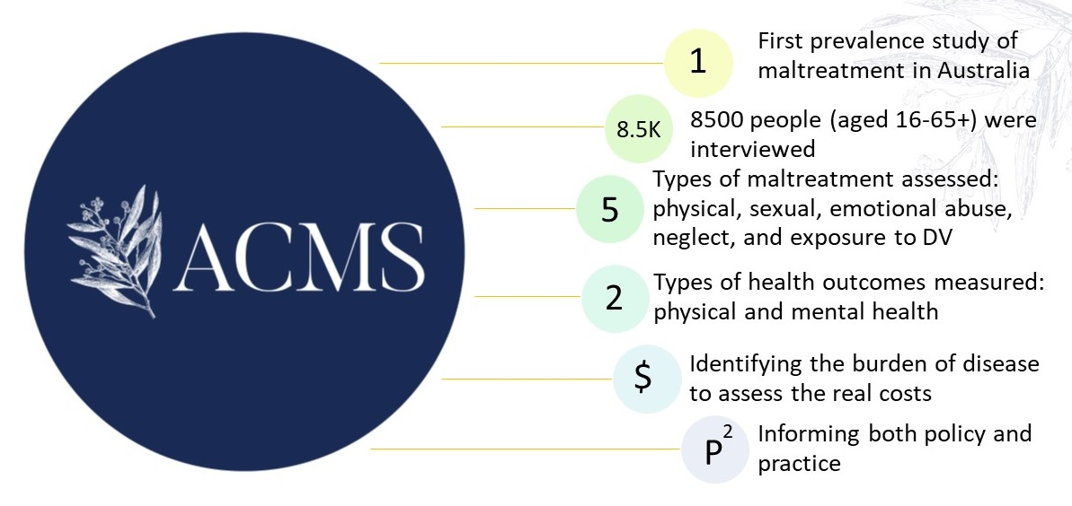
Australian Child Maltreatment Study
Mathews et al. (2021)

Slide 21


Australian Child Maltreatment Study
Project Grant 1158750
https://www.australianchildmaltreatmentstudy.org/

Slide 22
Lifetime prevalence of corporal punishment
(4+ times) in youth sample (16-24 yo)

Slide 23
Associations between corporal punishment & Major Depressive Disorder (Odds Ratios)
Sample | Unadjusted ORs | Adjusted OR* | Significance adjusted model
Female | 1.8 (1.4-2.3) | 1.3 (1.0-1.8) | Borderline
Male | 1.7 (1.3-2.4) | 1.4 (1.0-1.9) | Borderline
*Adjusted for all other forms of child maltreatment to account for overlap (95% confidence intervals)

Slide 24
Associations between corporal punishment & Generalised Anxiety Disorder
Sample | Unadjusted ORs | Adjusted OR* | Significance adjusted model
Female | 2.1 (1.6-2.7) | 1.6 (1.2-2.1)
Male | 1.6 (1.1-2.4) | 1.1 (0.7-1.7) | Nonsignificant
*Adjusted for all other forms of child maltreatment to account for overlap (95% confidence intervals)

Slide 25


Effect of corporal punishment on mental health
1.7x & 1.6x
Males were more likely to develop depression (1.7)
and anxiety (1.6)
1.6x
Females are significantly
more likely to report Generalised Anxiety Disorder
*After adjusting for other child abuse and neglect

Slide 26
Belief in need for corporal punishment is lower in younger age groups
% agreeing that corporal punishment is necessary to raise a child
Age group by years

Slide 27
Take home messages
Experience of corporal punishment in Australian youth is common (around 61%)
Corporal punishment places kids at greater odds of mental health problems
Children deserve violence-free childhoods
Support for the need for corporal punishment to raise children is declining dramatically by age, suggesting potential community readiness for change
2019 United Nations Committee on the Rights of the Child urged Australia to prohibit corporal punishment in all settings and to raise awareness of the adverse consequences of corporal punishment and promote positive alternative forms of discipline
61% of youth (16-24 year-olds)
experience corporal punishment

Slide 28


Alternatives to Corporal Punishment
David Hawes, PhD
Professor of Clinical Psychology
School of Psychology, University of Sydney
david.hawes@sydney.edu.au @David_J_Hawes

Slide 29

EFFECTIVE DISCIPLINE: KEY CRITERIA
1. Safe
2. Age appropriate
3. Effective in short- and long-term
4. Benefits extend to child and parent
5. Supported by intervention research

Slide 30
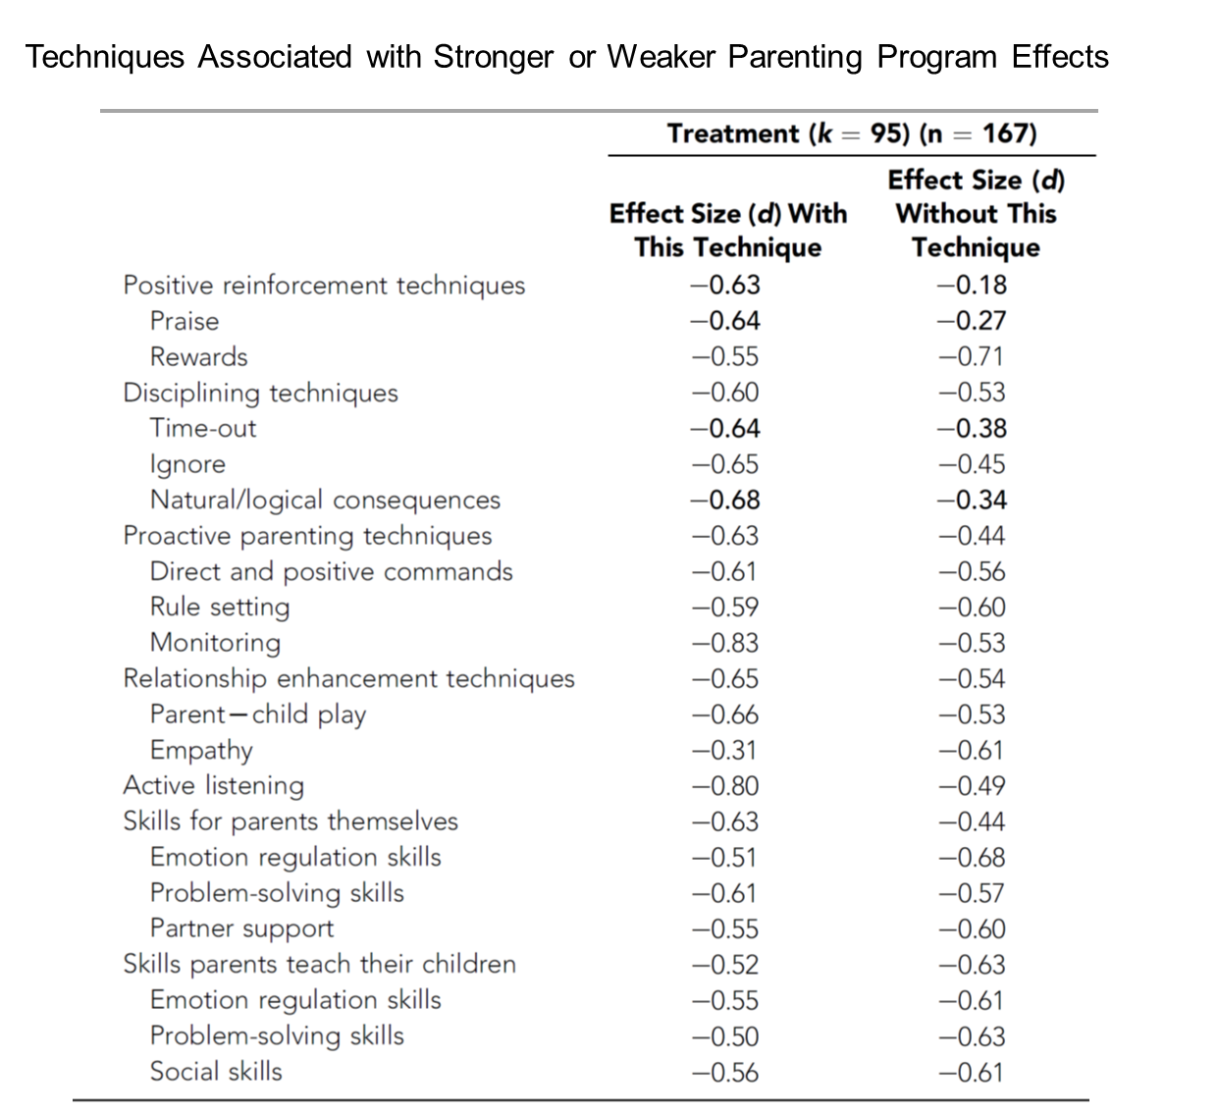
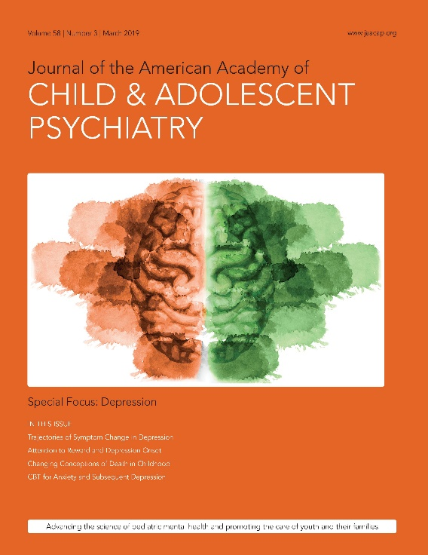
Leijten, P., Gardner, F., Melendez-Torres, G. J., van Aar, J., Hutchings, J., Schulz, S., Knerr, W., & Overbeek, G. (2019). Meta-analyses: Key parenting program components for disruptive child behavior. Journal of the American Academy of Child & Adolescent Psychiatry, 58(2), 180–190.

Slide 31
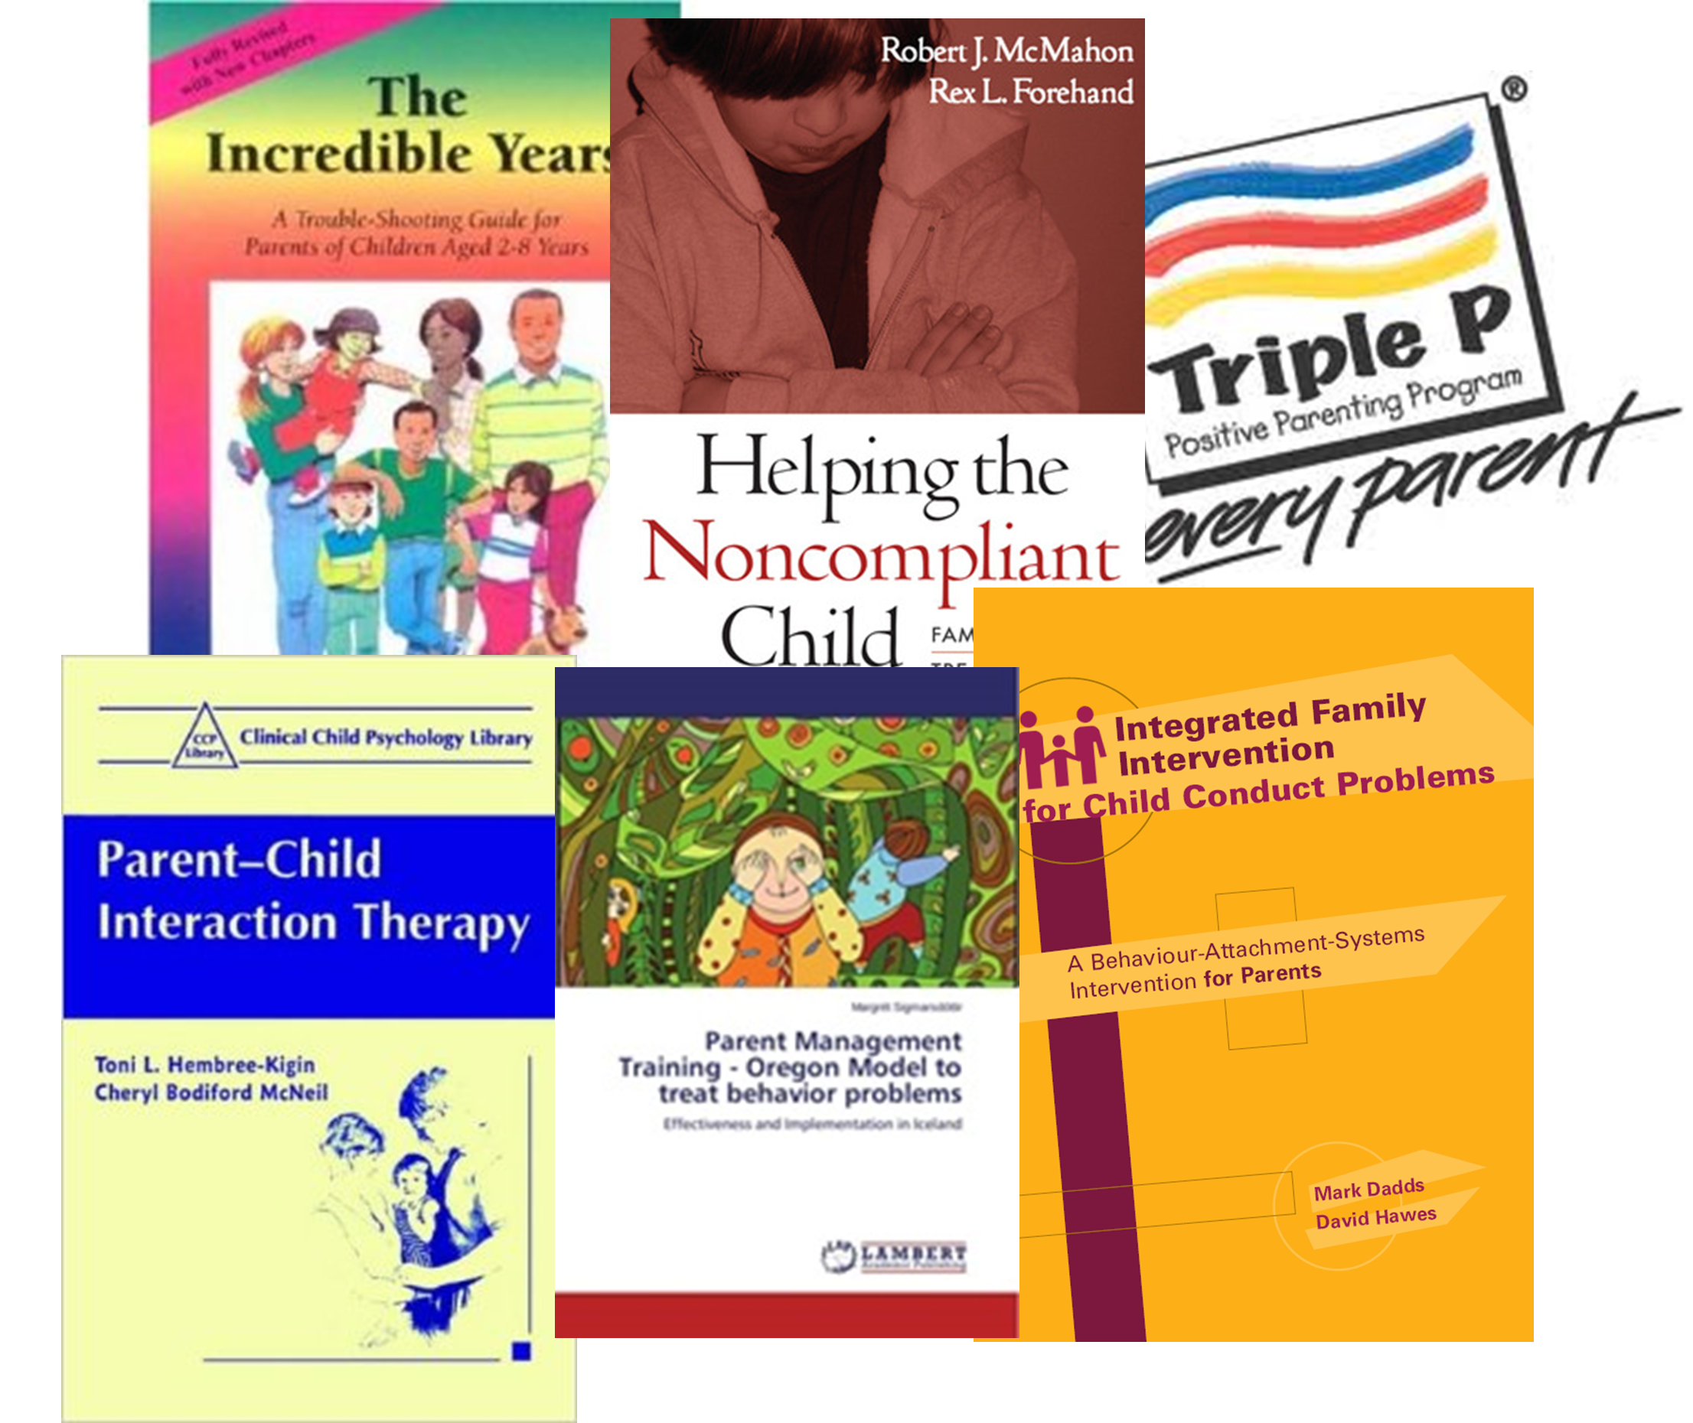
EFFECTIVE STRATEGIES: KEY EXAMPLES
TIME-OUT
“...from positive reinforcement”
Brief removal of access to rewards
Ages 2-to-8 years

Slide 32
EFFECTIVE STRATEGIES: KEY EXAMPLES
TIME-OUT
Escalation circuit-breaker
Self-regulation
Attachment security

Slide 33
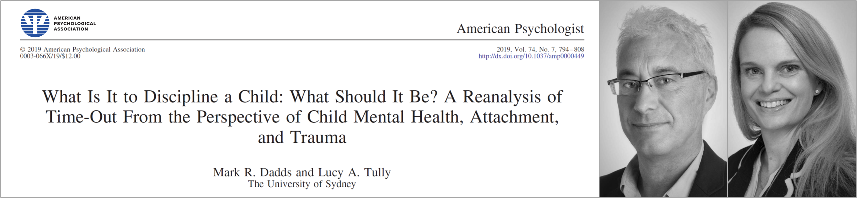
EFFECTIVE STRATEGIES: KEY EXAMPLES

Slide 34
EFFECTIVE STRATEGIES: KEY EXAMPLES
OTHER
CONSEQUENCES
Natural / logical
Pre-planned (older ages / adolescents)

Slide 35
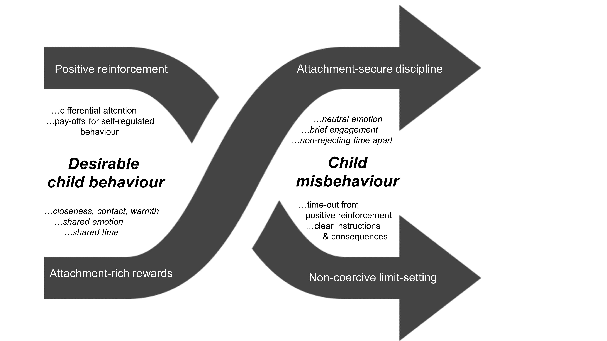
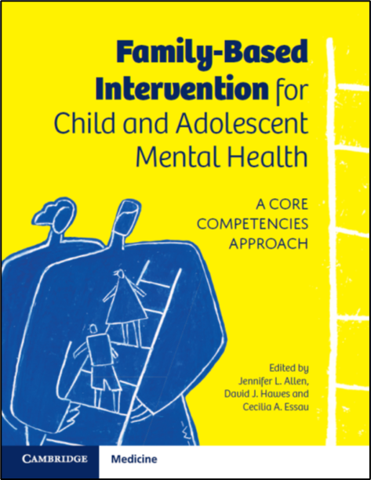
EFFECTIVE STRATEGIES: KEY EXAMPLES
Attachment and reinforcement as synergistic processes (Hawes & Dadds, 2021)

Slide 36
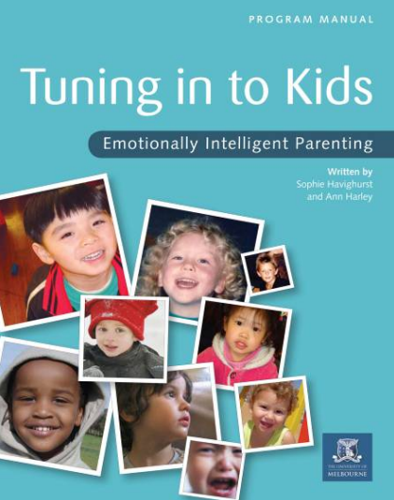
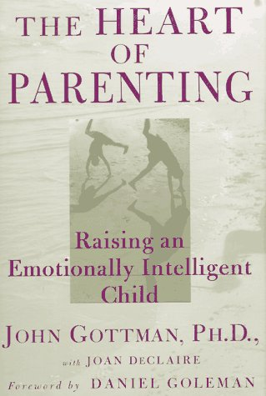
EFFECTIVE STRATEGIES: KEY EXAMPLES
EMOTION COACHING
Attending to emotional cues
Helping children name emotions
Supporting the sharing of emotions
Johnson, A. M., Hawes, D. J., Eisenberg, N., Kohlhoff, J., Dudeney, J. (2017). Emotion socialization and child conduct problems: A comprehensive review and meta-analysis. Clinical Psychology Review, 54, 65-80.

Slide 37
EFFECTIVE STRATEGIES: KEY EXAMPLES
PROACTIVE PARENTING
Preparing before challenging situations
Breaking difficult tasks into smaller ones
Giving children clear choices

Slide 38
CONCLUSIONS
Effective alternatives to corporal punishment are many
Some parents need more support than others
Australia is ready to support parents

Slide 39
Professor Sophie Havighurst
Mindful, Department of Psychiatry
The University of Melbourne sophie.h@unimelb.edu.au www.tuningintokids.org.au
International Experiences of Banning Corporal Punishment
Notes:
While 86% percent of children worldwide are not yet protected by legislation prohibiting against corporal punishment, 63 countries have now responded to the 1989 call from the United Nations Convention on the Rights of the Child and made corporal punishment illegal.

Slide 40
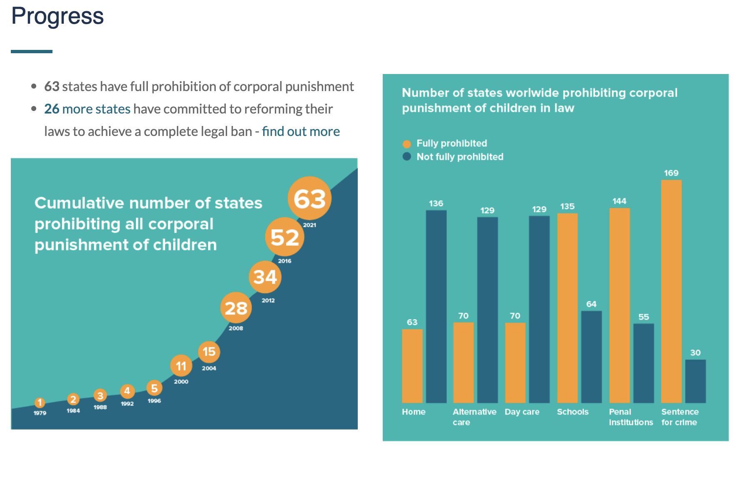
https://endcorporalpunishment.org/resources/research/

Slide 41
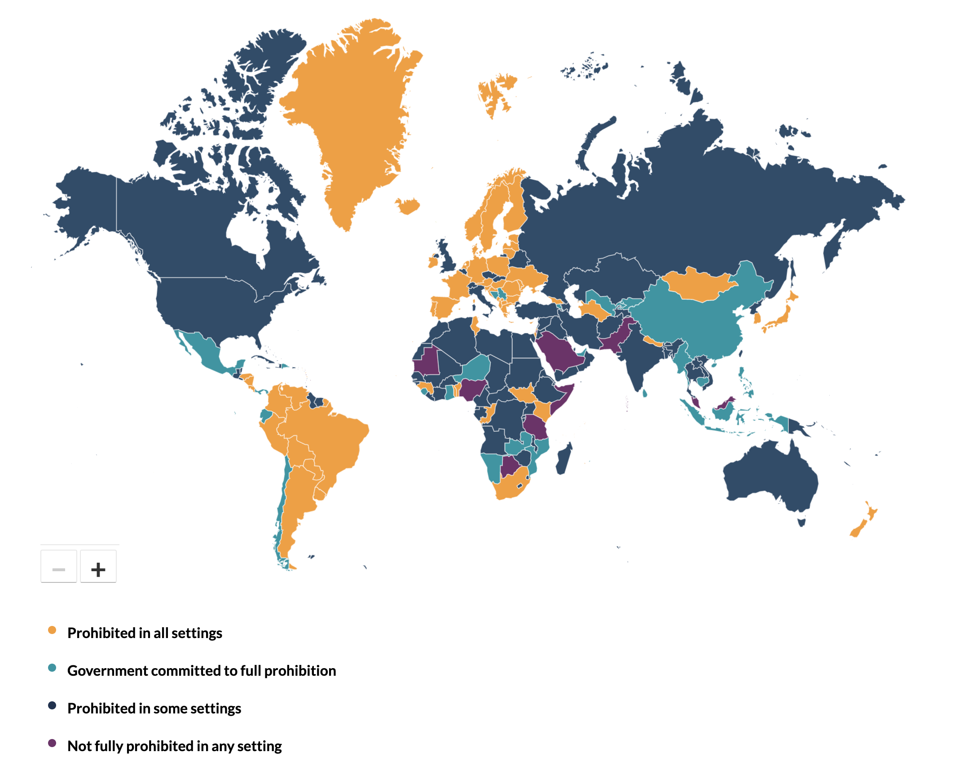
Notes:
https://endcorporalpunishment.org/ - map to the link

Slide 42
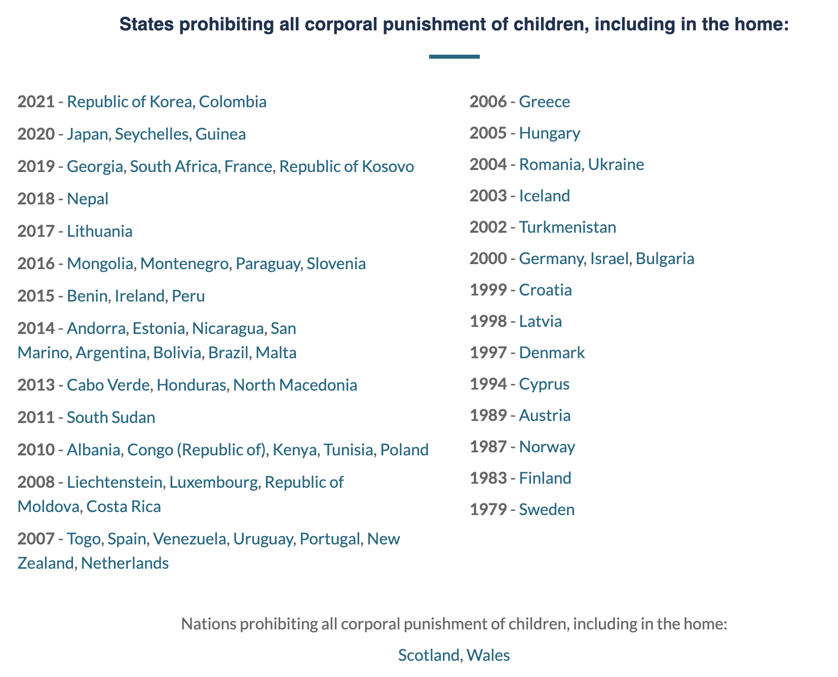
Notes:
63 countries
2 nations
Territories prohibiting all corporal punishment of children, including in the home:
Aruba (Netherlands), Curaçao (Netherlands), Faroe Islands (Denmark), French Guiana (France), Greenland (Denmark), Guadeloupe (France), Jersey (UK), Martinique (France), Mayotte (France), Pitcairn Islands (UK), Réunion (France), St Barthelemy (France), St Maarten (Netherlands), St Martin (France), Svalbard and Jan Mayen Islands (Norway), Wallis and Futuna Islands (France)
New Zealand was the first English-speaking country to make the shift in 2007, with Ireland, Scotland, and Wales following in more recent years.

Slide 43
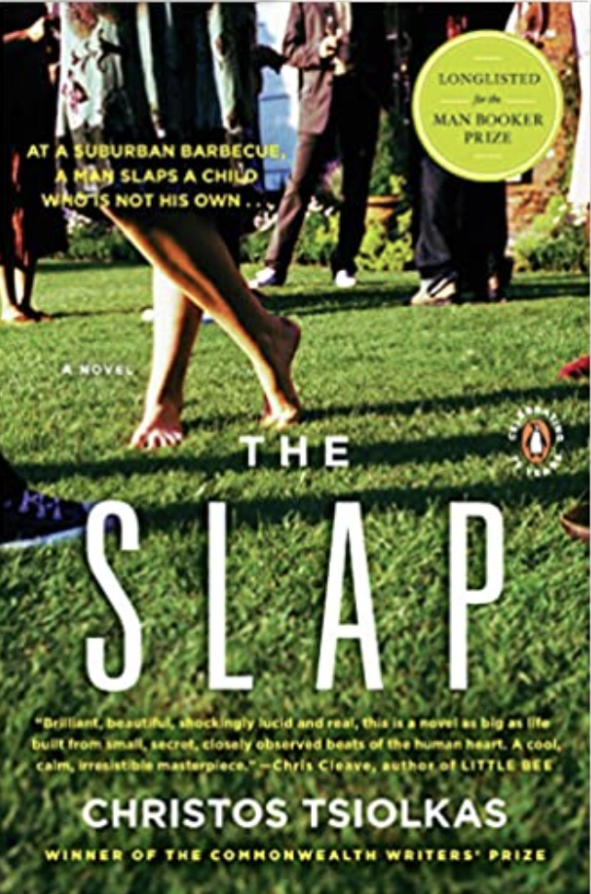
How does change occur?
What happens first?
Change in attitudes, behaviours or the law?
Changes in views about parenting and children’s rights over time – leading to reduced acceptance of corporal punishment
But is this enough??
What else is needed?

Slide 44
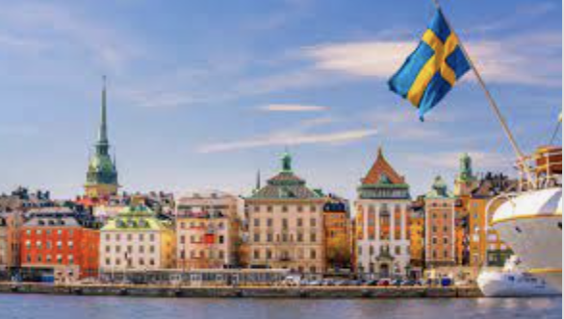
Case study: Sweden
Sweden first to change the law – 1979
1979 legislative change was introduced alongside:
  a significant public health campaign to raise awareness
  provision of a supportive child welfare system
  wide access to alternative parenting strategies
Attitudes of acceptance of CP have reduced over time:
  53% in 1965
  11% in 1996
Child/youth self-reports - 86% reported never having experienced CP in 2000
Child death rates due to physical punishment have remained very low since 1971
Notes:
Modig, C. (2009), Never Violence – Thirty Years on from Sweden’s Abolition of Corporal Punishment, Save the Children Sweden and Swedish Ministry of Health and Social Affairs
Hindberg, B. (2001). Ending corporal punishment: Swedish experience of efforts to prevent all forms of violence against children - and the results. Ministry of Health and Social Affairs, and Ministry of Foreign Affairs, Sweden.
Durrant, R. (2011). Collective violence: An evolutionary perspective. Aggression and Violent Behavior, 16(5), 428–436. https://doi.org/10.1016/j.avb.2011.04.014
Durrant, J. E. (1999). Evaluating the success of Sweden’s corporal punishment ban. Child abuse & neglect, 23(5), 435-448.

Slide 45
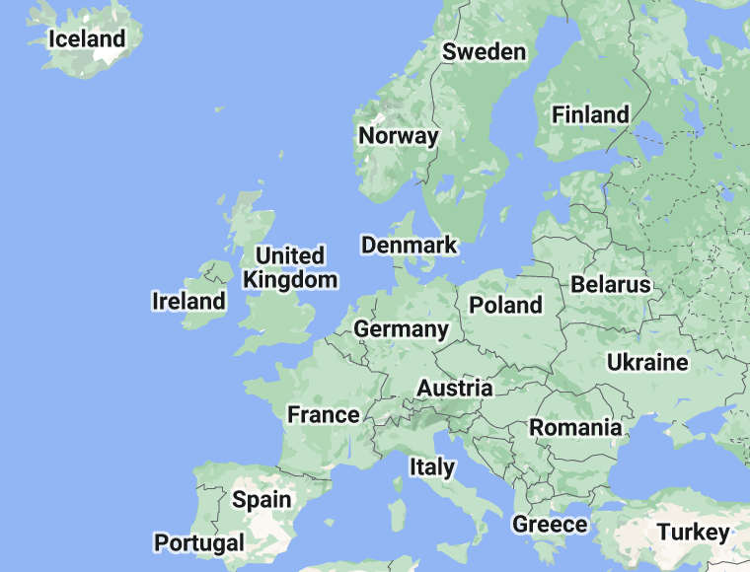
A cross country comparison
Bussmann et al. (2011) compared France, Spain, Austria, Germany & Sweden
Survey of 1000 parents in each country
Looked at legislation change & an educational campaign
Asked whether parents reported using mild CP with their child – e.g., ‘a mild slap on the face’: YES?
  France 71.5% of parents (no ban + no campaign)
  Spain 54.6% of parents (no ban + campaign)
  Austria 49.9% of parents (ban + no campaign)
  Germany 42.6% of parents (later ban + campaign)
  Sweden 14.1% of parents (early ban + campaign)
Examined own childhood of CP, & frequency of violence in parent relationship
Legislation change plus continuous campaigning is key
Notes:
The study also showed changes across generations, with a much greater proportion of Swedes being raised non-violently.
Further, 90% of Swedes knew about the laws prohibiting corporal punishment, while in Austria (32%) and Germany (31%) fewer parents were aware that a smack on a child’s bottom was illegal.
Continuous public health campaigning therefore appears essential to ensure members of the public are aware of the laws, know the harmful effects of corporal punishment, and are sensitised to alternatives to corporal punishment. This study also highlights the importance of measuring both attitudes and practices prior to and following legislative change to inform further educational and support strategies.

Slide 46
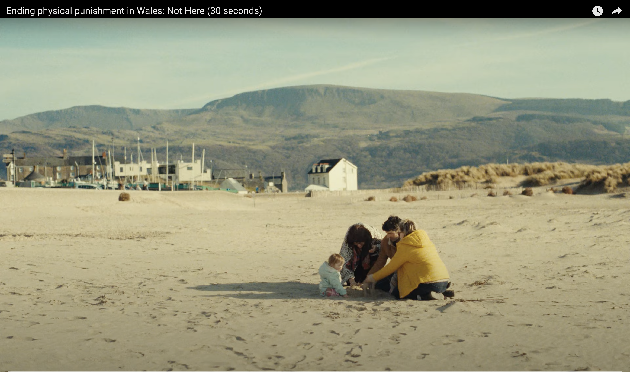
What’s needed in a public health campaign?
Example from Wales -
https://www.youtube.com/watch?v=FcCXL6lQjMM

Slide 47

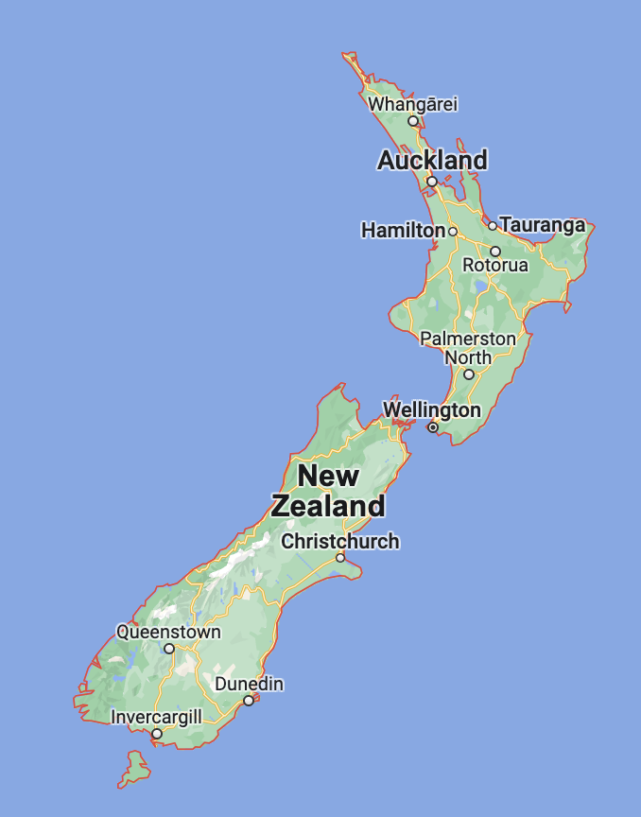
Case study: New Zealand
Since late 1980’s drive to change legislation – long advocacy
Government funded parenting campaign (SKIP: Strategies with Kids: Information for Parents)
Advocacy with many communities including Māori and Pacific Island
2007 finally - legislation change
Attitudes to CP changing prior to law change but significant acceleration post-legislation. Parent approval ratings of CP were:
    89% in 1981
    87% in 1993
    58% in 2008 (the year after law change)
    35% in 2013
    19% in 2018 (McLeod et al., 2021; Wood, 2013).
2 years after 2007 - 12 cases seen by police for smacking – no prosecutions
Ending Punishment of Children (EPOCH) - Save the Children https://www.epochnz.org.nz/
Wood, B., Hassall, I., Hook, G., & Ludbrook, R. (2008). Unreasonable Force: New Zealand's Journey towards Banning the Physical Punishment of Children. Save the Children New Zealand.
https://resourcecentre.savethechildren.net/document/unreasonable-force-new-zealands-journey-towards-banning-physical-punishment-children/
Notes:
Wood, B., Hassall, I., Hook, G., & Ludbrook, R. (2008). Unreasonable Force: New Zealand's Journey towards Banning the Physical Punishment of Children. Save the Children New Zealand. https://resourcecentre.savethechildren.net/document/unreasonable-force-new-zealands-journey-towards-banning-physical-punishment-children/
In total, 355 child assault events attended by police during this period were considered for the eleventh review. 12 of these events were identified as involving smacking and 31 involved 'minor acts of physical discipline'.
In the two years following law reform, NZ Police monitored corporal punishment/smacking reports and continued to record the impact of the law for an additional year. Monitoring over the three year period following legislative change found that of 335 recorded prosecutions for child assaults only 12 were for smacking (none resulted in prosecution) and 31 for minor acts of physical discipline (9 of which resulted in prosecution), with an overall reduction in all types of incidents. Initial fears that ‘good parents’ would be prosecuted for smacking were proven unfounded (New Zealand Police, 2013).

Slide 48
Concluding Points from seminar
CP breaches children’s right to be free from violence
CP has no benefits to children – only detrimental effects
Intergenerational effects of CP on later domestic violence/CP
In whose interests do we maintain these archaic laws?
Changes in law in other countries occurred prior to reductions in attitude and behaviour change
Countries with the most ideal outcomes have instigated public health campaigns educating the population about the law reform while also providing access to alternatives to corporal punishment (i.e., learning non-violent discipline strategies).
We do not need to wait for changes in attitudes to occur
We need to take action now.
Notes:
as outlined in the UN Sustainable Development Goal of ending all forms of violence against children.
Convention on the Rights of the Child
Detrimental effects
Reducing trust and connection with those children are closest to, lowering self-esteem, increasing behaviour problems, mental health difficulties and increasing risk for later substance abuse, antisocial behaviour and poorer outcomes
Whether taking an evidence-based approach (i.e., considering adverse impacts) or a child-rights perspective (i.e., children deserve the same right to be free from violence as afforded to adults), continuing to allow corporal punishment of children by their parents and carers is antithetical to the wellbeing of children in Australia.

Slide 49
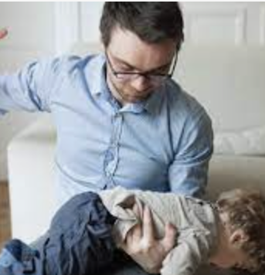
The hypocrisy of using corporal punishment with children is well summed up by child psychologist, Haim Ginnot.
“When a child hits a child, we call it aggression.
When a child hits an adult, we call it hostility.
When an adult hits an adult, we call it assault.
When an adult hits a child, we call it discipline.”

Slide 50
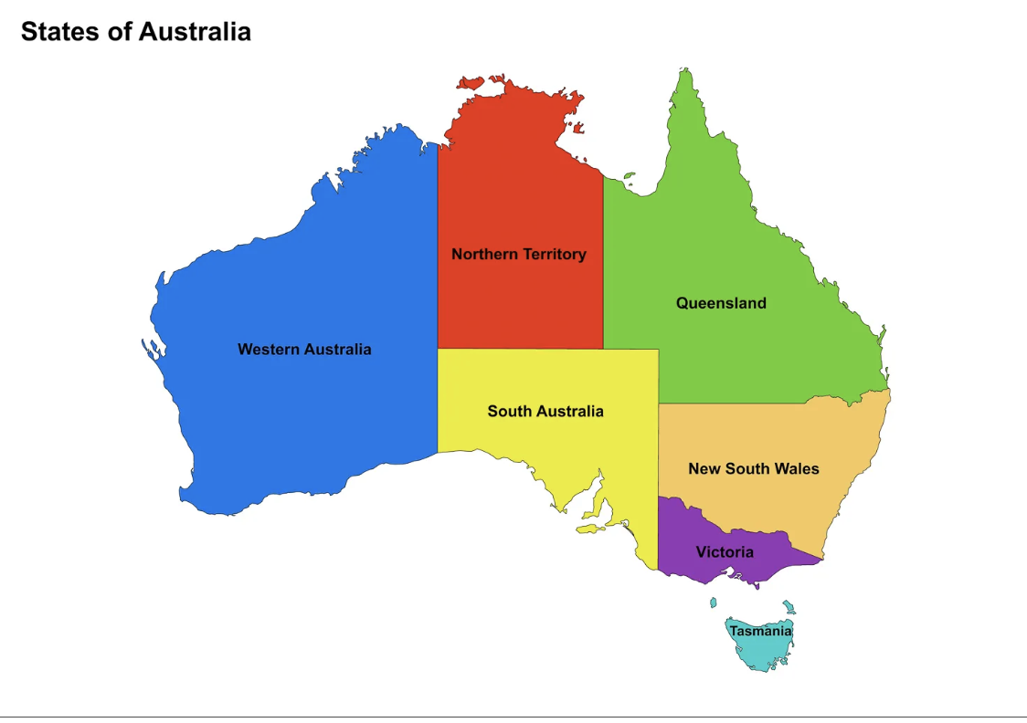
Recommendations
Australia needs:
legal reform in each state/ territory to prohibit CP
public health campaign to inform people law has changed
increase access/reach culturally appropriate parenting strategies and evidence-based parenting programs that provide alternative discipline strategies (Doyle et al., 2022)
whole-of-government approach for appropriate, holistic health/law enforcement (i.e., alternatives to prosecution)
a national survey to monitor attitude/behaviour change
monitor child wellbeing and rates of child maltreatment.
Notes:
Australia needs to:
enact legal reform in each state and territory to prohibit corporal punishment of children;
determine the nature of significant risk factors for corporal punishment and provide additional prevention and support measures for individuals who may be most in need;
increase access to, and reach of, culturally appropriate parenting strategies that provide an alternative discipline strategy to corporal punishment;
provide population-level access to free or low-cost evidence-based parenting programs with more intensive supports available for families with risk for engaging in corporal punishment or maltreatment (as outlined by Doyle et al., 2022);
implement a public health campaign to inform the population the law has changed (e.g., https://gov.wales/ending-physical-punishment-children), while accurately explaining the consequences of this change;
employ a whole-of-government approach to ensure appropriate, holistic health and law enforcement approaches (including alternatives to prosecution); and
measure the impact of change through a regular national parenting survey to monitor attitudes towards, and use of, corporal punishment and alternative discipline practices, and use nationally representative surveys to monitor child wellbeing and prevalence of child maltreatment to see whether improvements occur.

Slide 51
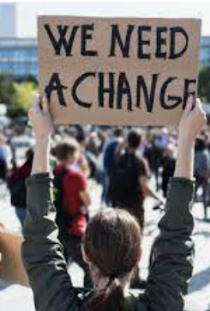
What can you do?
Talk to others about banning corporal punishment
Include CP questions in your research
Support raising awareness of the harmful effects with a balance with alternative parenting strategies
Ask communities what would help them to bring about change?
Engage key influencers/leaders in this pursuit – find our champions for change
Write to your local MP - requesting legislation change to prohibit corporal punishment of children
Join our advocacy campaign (email Sophie, Daryl or Maria Battaglia maria.battaglia@acu.edu.au
Other actions?

Slide 52
Acknowledgements
PAFRA
Authors on Journal paper
Maria Battaglia –media/comms ACU
Professor Joan Durrant – Canadian academic and CP law change advocate
Beth Wood –campaigner in NZ and EPOCH
Bess Herbert - End Corporal Punishment of Children

Slide 53
Discussion questions or comments
How do we address the fact that the ‘personal is political’ – in that a person’s own childhood experience of corporal punishment, or their use of it as a parent may influence their commitment (or resistance) to change?
How do we reduce the split between them and us? How to engage all people regardless of whether they have used CP or not?
Does emphasizing the long-term harms of corporal punishment undermine advocacy attempts?
Does the strategy for policy and legal reform need to differentiate between (a) those who are generally child wellbeing advocates, but don’t see the need to have law reform on corporal punishment, and (b) those who might be more resistant to child-focused arguments?
Which state or territory in Australia are we more likely to have an early success in changing the law?
Your own questions or comments?

Slide 54
SEMINAR SERIES
2022

